Slide 1
Introduction to Agile - Scrum

Slide 2







Elements of Agile Adoption
Process
Engineering Practices

Slide 3
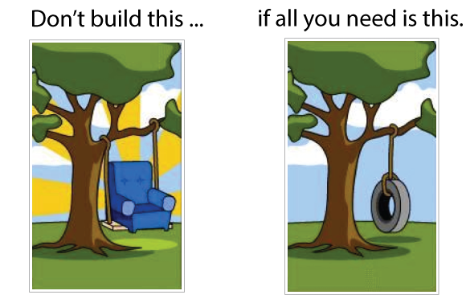
Requirement

Slide 4
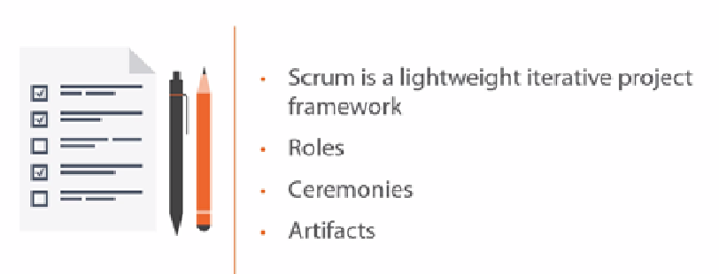
Scrum Overview

Slide 5
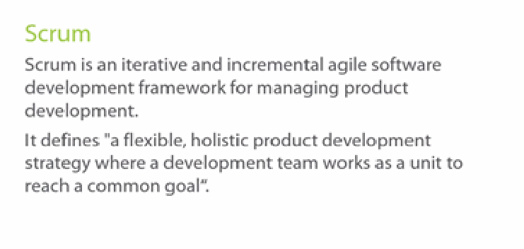
SCRUM

Slide 6
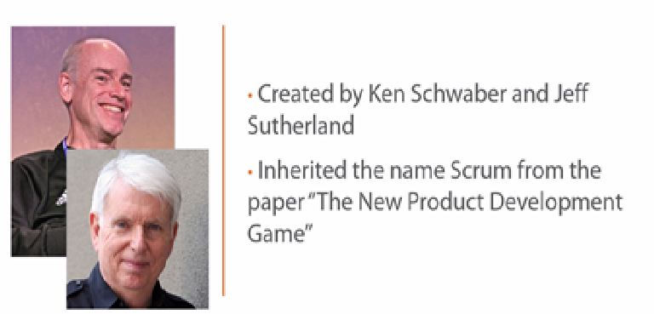
History of Scrum

Slide 7
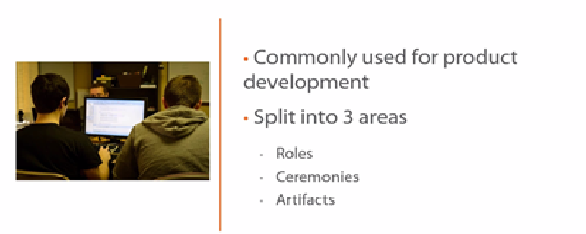
Overview of Scrum

Slide 8
Scrum has been used by:
Microsoft
Yahoo
Google
Electronic Arts
High Moon Studios
Lockheed Martin
Philips
Siemens
Nokia
Capital One
BBC
Intuit
Intuit
Nielsen Media
First American Real Estate
BMC Software
Ipswitch
John Deere
Lexis Nexis
Sabre
Salesforce.com
Time Warner
Turner Broadcasting
Oce

Slide 9
Characteristics
Scrum Values: Focus, Respect, Commitment, Openness and Courage.
Self-organizing teams
Product progresses in a series of period-long “sprints”
Requirements are captured as items in a list of “product backlog”
No specific engineering practices prescribed
Uses generative rules to create an agile environment for delivering projects
One of the “agile processes”

Slide 10
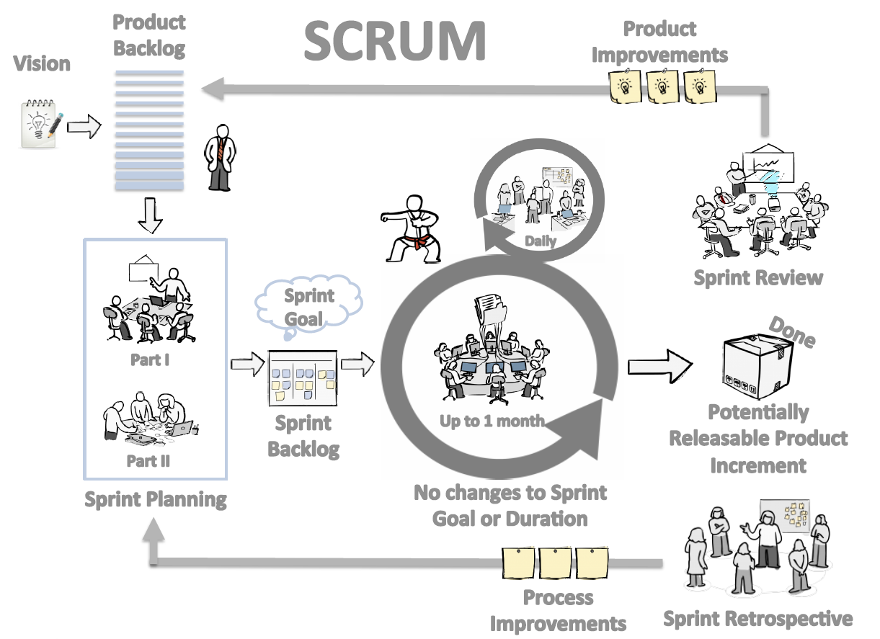
Scrum at a Glance

Slide 11
Sprints
Scrum projects make progress in a series of “sprints”. Fixed Goal, Team, Length
Typical duration is 2–4 weeks or a calendar month at most
Why Timeboxing?
A constant duration leads to a better rhythm
Improve predictability
Help stay focused on Goal
Product is designed, coded, and tested during the sprint

Slide 12


No changes during a sprint
Change
Plan sprint durations around how long you can commit to keeping change out of the sprint

Slide 13

Scrum framework
Roles
Product owner
ScrumMaster
Team
Ceremonies
Sprint planning
Sprint review
Sprint retrospective
Daily scrum meeting
Artifacts
Product backlog
Sprint backlog
Burndown charts

Slide 14
Scrum framework
Roles
Product owner
ScrumMaster
Team
Ceremonies
Sprint planning
Sprint review
Sprint retrospective
Daily scrum meeting
Artifacts
Product backlog
Sprint backlog
Burndown charts

Slide 15







Scrum Roles
Product Owner
Possibly a Product Manager or Project Sponsor
Decides features, release date, prioritization, $$$
Scrum Master
Typically a Project & Process Co-ordinator or Team Leader
Responsible for enacting Scrum values and practices
Remove impediments / politics, keeps everyone productive
Project Team
5-10 members; Teams are self-organizing
Cross-functional: QA, Programmers, UI Designers, etc.
Membership should change only between sprints

Slide 16

Product owner
Define the features of the product
Decide on release date and content
Be responsible for the profitability of the product (ROI)
Prioritize features according to market value
Adjust features and priority every iteration, as needed
Accept or reject work results
Responsible for:
Product Vision
Stakeholder management
Scope Management
Cost Management
Monitoring Release progress

Slide 17

The ScrumMaster
Responsible for facilitation of all ceremonies
Responsible for enacting Scrum values and practices
Removes impediments
Ensure that the team is fully functional and productive
Enable close cooperation across all roles and functions
Shield the team from external interferences

Slide 18
The team
Typically 5-9 people
Cross-functional:
Programmers, testers, user experience designers, etc.
Members should be full-time
May be exceptions (e.g., database administrator)

Slide 19
The team
Teams are self-organizing
Ideally, no titles but rarely a possibility
Membership should change only between sprints

Slide 20
Agreement - Definition of “Ready” (DoR)
For a Story to be “Ready”, following criteria have to be met
The story should reasonably show INVEST characteristics
I – Independent / Immediately actionable
N – Negotiable
V – Valuable to the customer, user or product
E – Estimable
S – Sized to fit
T – Testable
The business implications of the story have been discussed, any impacts to finance, customer care have been addressed
The User Interaction Design is ready (At the very least wireframes covering all interactions of the story should be available)
Any design assets needed for the story have been prepared to a reasonable degree (PSDs for some if not all pages in the Story should be available)

Slide 21
Agreement - Definition of “Done” (DoD)
Definition of Done must describe exactly what “done” means
Product Owner must pay careful attention when defining the DoD
The scrum team must challenge the DoD, if necessary
“What’s not in DoD, is not needed”
Item is either “done” or “not done”
Example:
Story: Picture upload
end user can upload his/her picture from profile settings page
picture is shown on the left upper corner of the profile page
picture is scaled to fit the profile picture box on the profile page
functional tests are passed
regression tests are passed
design documents are updated
user's guide is updated
Does not define any details of the implementation!

Slide 22
Scrum framework
Roles
Product owner
ScrumMaster
Team
Ceremonies
Sprint planning
Sprint review
Sprint retrospective
Daily scrum meeting
Artifacts
Product backlog
Sprint backlog
Burndown charts

Slide 23
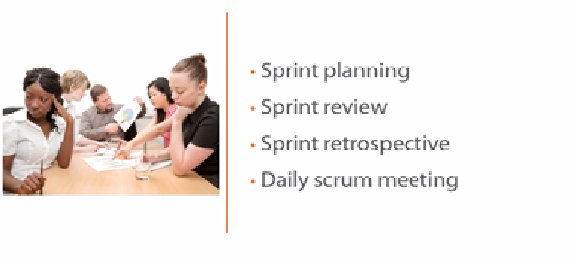
Scrum Ceremonies

Slide 24
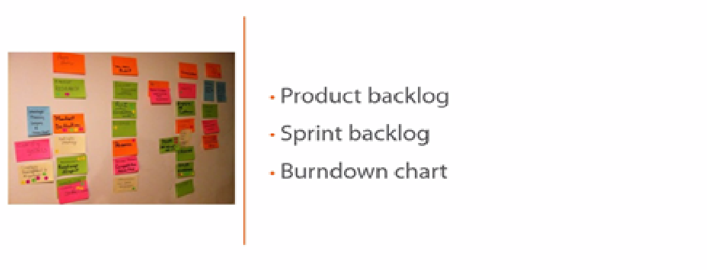
Scrum Artifacts

Slide 25
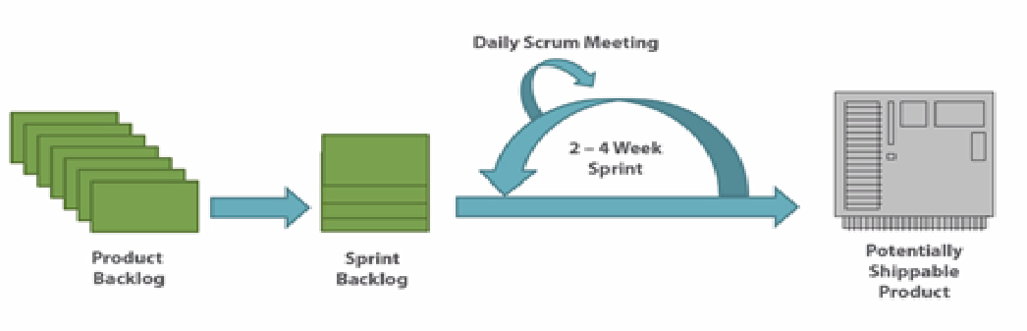
SCRUM DIAGRAM

Slide 26
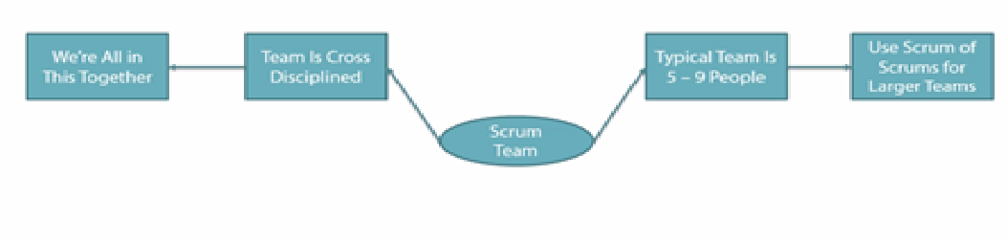
Scrum Team

Slide 27

Scrum ceremonies

Slide 28
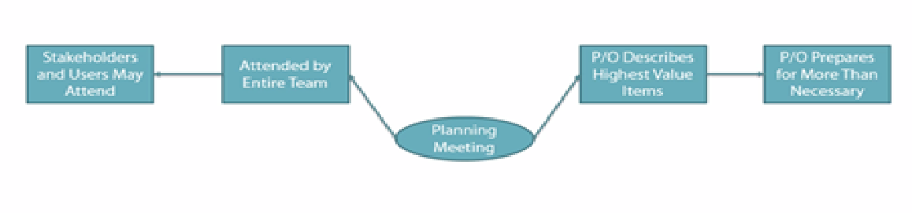
Planning Meeting

Slide 29
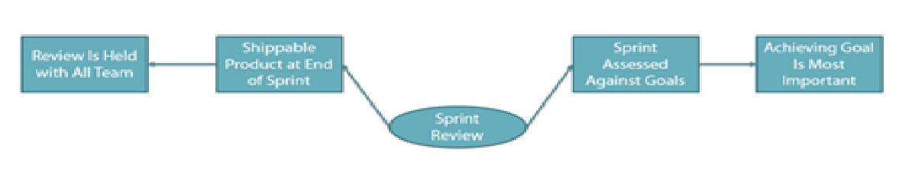
Sprint Review

Slide 30
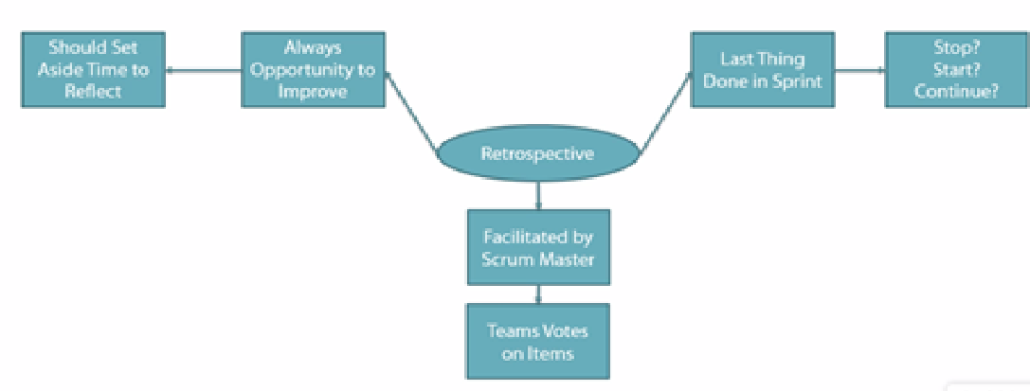
Sprint Retrospective

Slide 31
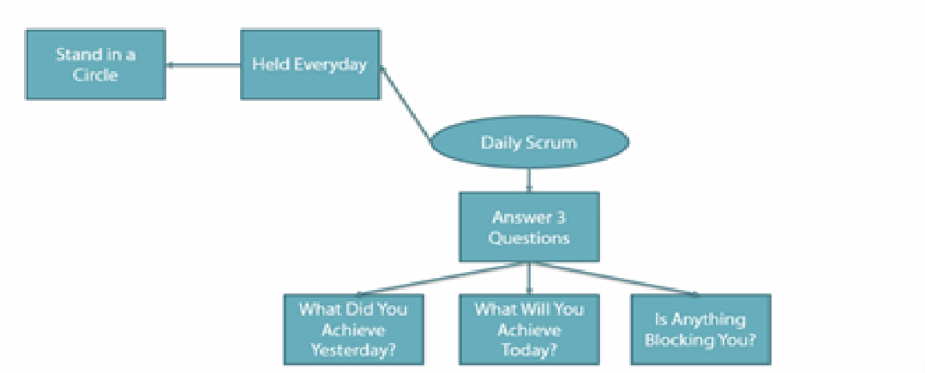
Daily Scrum

Slide 32
Scrum Artifacts

Slide 33
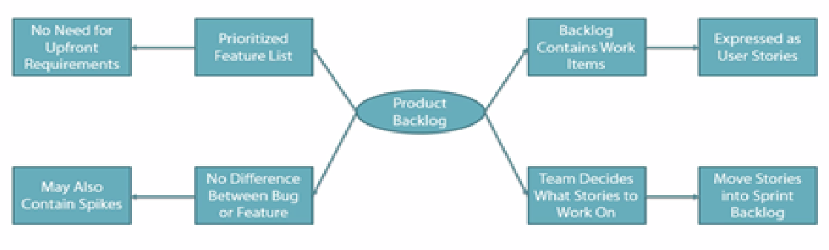
Product Backlog

Slide 34
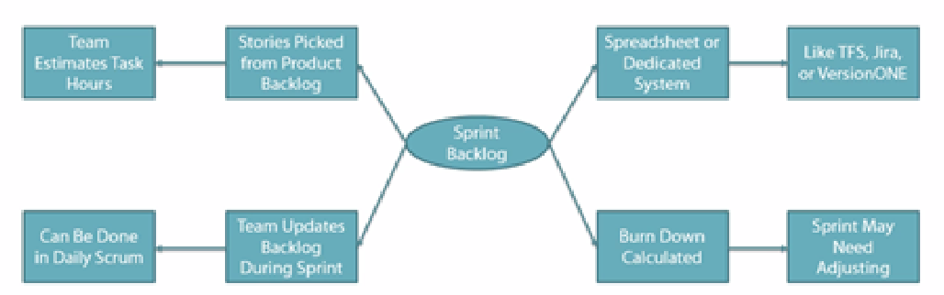
Sprint Backlog

Slide 35
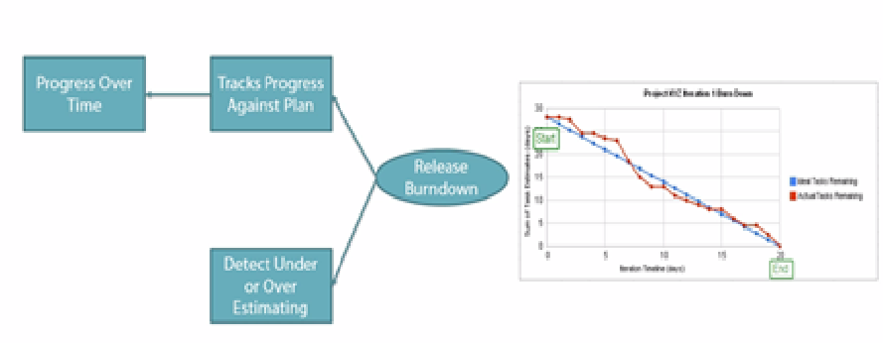
Burn Down Chart

Slide 36
Scrum with 2 weeks Sprint Duration
Scrum Ceremonies and important meetings during one Sprint
Day 1
Day 2
Day 3
Day 4
Day 5
9 am
11 am
1 pm
3 pm
5 pmv
Sprint Planning
PO + SM + Dev Team
Daily Scrum
Daily Scrum
Daily Scrum
Daily Scrum
Add on meetings
SM + Dev + PO
Add on meetings
SM + Dev + PO
Add on meetings
SM + Dev + PO
Add on meetings
SM + Dev + PO
Backlog Refinement
PO + SM + Dev
Day 6
Day 7
Day 8
Day 9
Day 10
9 am
11 am
1 pm
3 pm
5 pm
Daily Scrum
Daily Scrum
Daily Scrum
Daily Scrum
Daily Scrum
Add on meetings
SM + Dev + PO
Add on meetings
SM + Dev + PO
Add on meetings
SM + Dev + PO
Add on meetings
SM + Dev + PO
Sprint Review
(PO + SM + DevTeam) + key Stakeholders
Backlog Refinement
PO + SM + Dev
Sprint Retrospection
(PO + SM + DevTeam)
Sprint (2 weeks)
Timing of non ceremonial meetings (e.g. Backlog refinement meeting) may varies with Sprint / Team
Ceremonies
Mandatory meeting but not a scrum ceremony
Optional meeting and not a scrum ceremony

Slide 37



Team capacity
Sprint planning meeting
Sprint prioritization
Product backlog
Sprint
goal
Analyze and evaluate product backlog
Select sprint goal
Business conditions
Sprint planning
Decide how to achieve sprint goal (design)
Create sprint backlog (tasks) from product backlog items (user stories / features)
Estimate sprint backlog in hours
Current product
Sprint
backlog
Technology

Slide 38

Sprint planning
Team selects items from the product backlog they can commit to completing
Sprint backlog is created
Tasks are identified and each is estimated (1-16 hours)
Collaboratively, not done alone by the ScrumMaster
High-level design is considered
As a vacation planner, I want to see photos of the hotels.
Code the middle tier (8 hours)
Code the user interface (4)
Write test fixtures (4)
Code the foo class (6)
Update performance tests (4)

Slide 39
The daily scrum
Parameters
Daily
15-minutes
Stand-up
Not for problem solving
Whole world is invited
Only team members, ScrumMaster, product owner, can talk
Helps avoid other unnecessary meetings

Slide 40

Everyone answers 3 questions
1
What did you do yesterday?
2
What will you do today?
3
Is anything in your way?
These are not status for the ScrumMaster
They are commitments in front of peers

Slide 41
The sprint review
Team presents what it accomplished during the sprint
Typically takes the form of a demo of new features or underlying architecture
Informal
2-hour prep time rule
No slides
Whole team participates
Invite the world

Slide 42
Sprint retrospective
Periodically take a look at what is and is not working
Typically 15–30 minutes
Done after every sprint
Whole team participates
ScrumMaster
Product owner
Team
Possibly customers and others

Slide 43

Start / Stop / Continue
Whole team gathers and discusses what they’d like to:
Start doing
Stop doing
This is just one of many ways to do a sprint retrospective.
Continue doing

Slide 44
Scrum framework
Roles
Product owner
ScrumMaster
Team
Ceremonies
Sprint planning
Sprint review
Sprint retrospective
Daily scrum meeting
Artifacts
Product backlog
Sprint backlog
Burndown charts

Slide 45

Product backlog
The requirements
A list of all desired work on the project
Ideally expressed such that each item has value to the users or customers of the product
Prioritized by the product owner
Reprioritized at the start of each sprint
This is the product backlog

Slide 46
Sample Product Backlog
Backlog item | Estimate
Allow a guest to make a reservation | 3 (story points)
As a guest, I want to cancel a reservation. | 5
As a guest, I want to change the dates of a reservation. | 3
As a hotel employee, I can run Revenue reports | 8
Improve exception handling | 8
... | 30
... | 50

Slide 47
The sprint goal
A short statement of what the work will be focused on during the sprint
Life Sciences
Support features necessary for population genetics studies.
Database Application
Make the application run on SQL Server in addition to Oracle.
Financial services
Support more technical indicators than company ABC with real-time, streaming data.

Slide 48
Sprint Backlog
Individuals sign up for work of their own choosing
Work is never assigned
Estimated work remaining is updated daily
Any team member can add, delete change sprint backlog
Work for the sprint emerges
If work is unclear, define a sprint backlog item with a larger amount of time and break it down later
Update work remaining as more becomes known

Slide 49
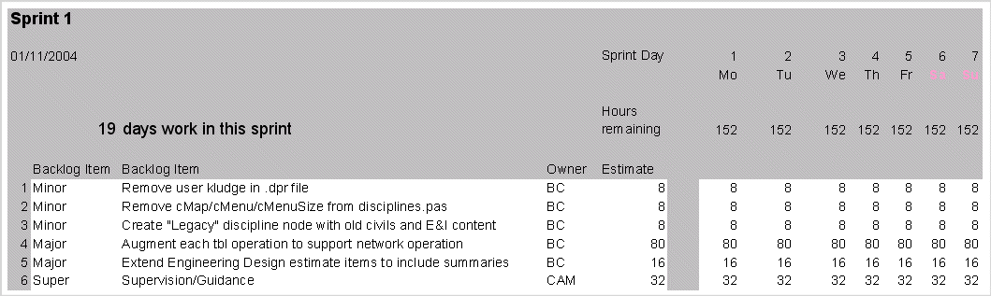
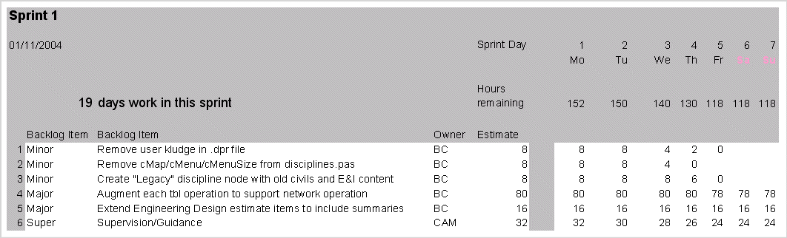
Sample Sprint Backlog
01/11/2015
01/11/2015

Slide 50
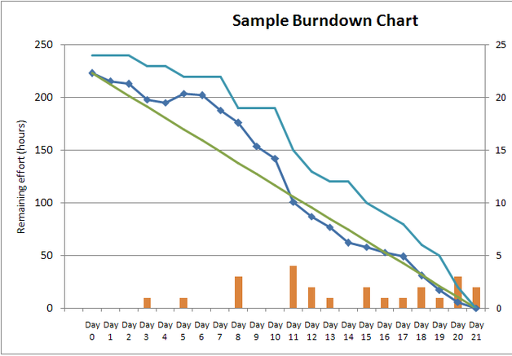
Sprint Burndown
A display of what work has been completed and what is left to complete
one for each developer or work item
updated every day
(make best guess about hours/points completed each day)
Gives indication to:
No work being performed
Not fast enough work
Too fast work
variation: Release burndown chart
shows overall progress
updated at end of each sprint

Slide 51

Tasks
Mon
Tues
Wed
Thur
Fri
Code the user interface
8
4
8
Code the middle tier
16
12
10
7
Test the middle tier
8
16
16
11
8
Write online help
12
50
40
30
Hours
20
10
0
Mon
Tue
Wed
Thu
Fri

Slide 52
Scrum board
Product
backlog
Sprint
backlog
Task
Development
Review
Exploratory Testing
UAT
WIP
Done
WIP
Done
WIP
Done
Story 1
Story 2
Story 3
The scrum board depiction here is just a sample; and should be customized as per project need and nature

Slide 53
Fire line on scrum board
Product
backlog
Sprint
backlog
Task
Development
Review
Exploratory Testing
UAT
WIP
Done
WIP
Done
WIP
Done
FIRE LINE
Story 1
Story 2
Story 3
Items in Fire line can be directly added without going through product backlog or Sprint planning
The scrum board depiction here is just a sample; and should be customized as per project need and nature

Slide 54
Kanban
5
3
3
Product
backlog
TODO
Task
Development
Review
Exploratory Testing
UAT
WIP
Done
WIP
Done
WIP
Done
Story 1
Story 2
Items in Fire line can be directly added without going through product backlog or Sprint planning
Story 3
The kanban board depiction here is just a sample; and should be customized as per project need and nature

Slide 55
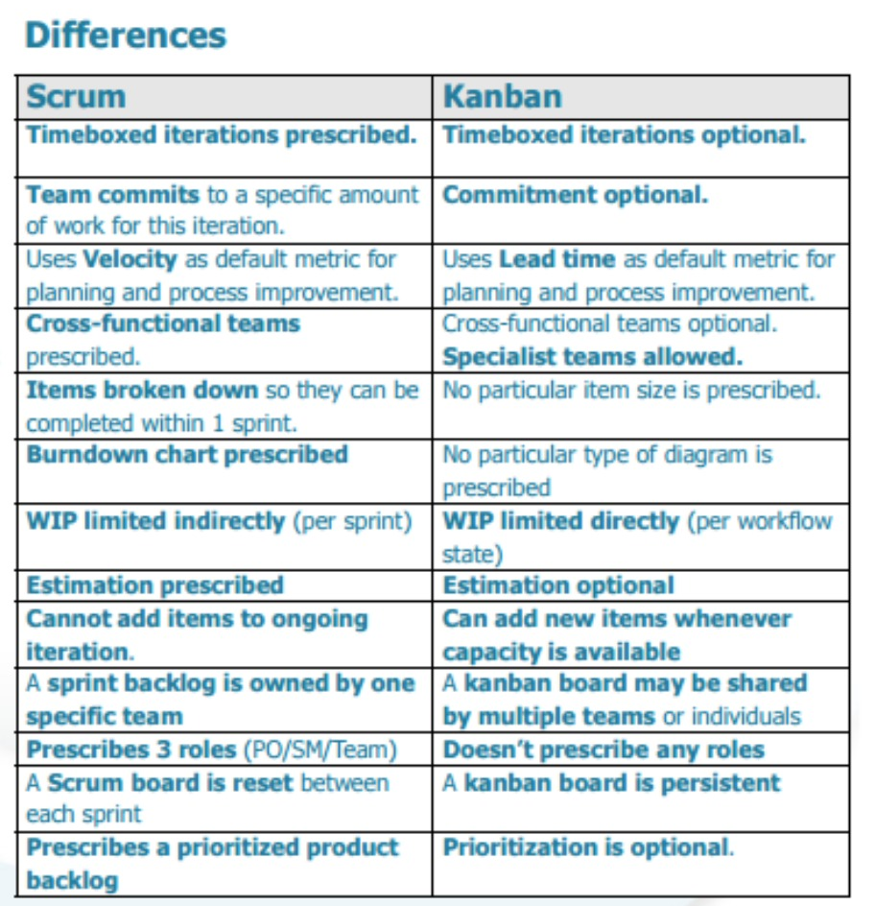

Slide 56

Myths or Facts
Agile is anti
documentation
Agile is undisciplined
Road map and release plan
is essential in Agile
Agile means
small water falls
Agile works well
for big projects
Agile required
lots of rework
Agile doesn’t scale
Agile is anti
architecture

Slide 57
Success Selfie!
Going agile is all about building a great development culture in your organization.
Effective cross-functionalism
Self organizing team
Don’t be critical-path developers, cross-train each other
Cross-pollinate though effective code review
Cultivate full-stack developers

Slide 58











Agile Engineering Practices
User Stories
Must have
Acceptance Criteria
Development Team
Technical discussion of Story
TDD
Test Driven Development
BDD
Behavior driven development
PO, BA, Test Lead
Code review
Agile way – ensuring all acceptance criteria are covered in TDD & BDD
Validation of Acceptance criteria
Unit Test
Coverage > 70 %
Progress & feedback Reporting
Pear
Review
Code Merge in
SCM / Repository
Client / Stakeholder, PO, Scrum master
Project management Tool (JIRA)
Code quality review automation (Sonar / CAST)
Burn Down, Scrum Board
Continuous Integration (CI)
For QA Build
Continuous Integration (CI)
Automated Build report
Shippable
Code
Review of DoD
(Definition of Done)
Exploratory
Testing

Slide 59

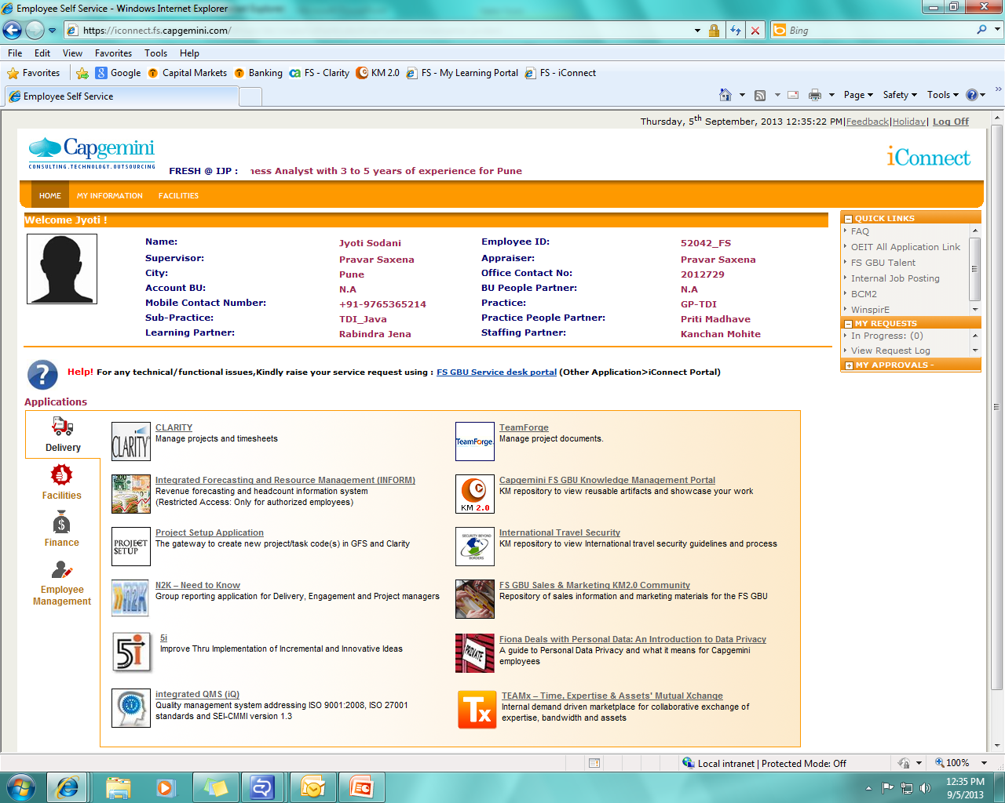



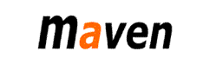














Agile Engineering Practices: Suggested Tools
Project Management
SCM
(code repository)
SVN
Build
Continuous Integration
Artifact management
Code quality & review
Unit and Automation Testing
Rapid Prototyping

Slide 60
Agile Transformation - Road Map and Milestones
2016…
Agile Adoption For
Feb
March
April
May
June
July
August
September
October
November
December
Individual
Agile For Developers Trainings / Certifications
Engineering Practices
50% resources are trained in agile engineering practices
70% resources are trained in agile engineering practices
100% resources are trained in agile engineering practices
Environment
Strong Engineering Practices, Tools and DevOps Adoption
Tools / Infrastructure
Automation / DevOps
Readiness and Maturity Assessment
Achieve Continuous Integration for Pilot Team
Auto code quality tool (Sonar) set up for Pilot Projects
JIRA for Scrum management
Achieve TDD Approach for Pilot team/project
20% decrease in technical debt
40% functional automation of new development
40% decrease in technical debt
60% functional automation of new development
100% functional automation of new development
60% decrease in technical debt
Continuous delivery pipeline for all towers
Team
Scrum ceremonies in Place, Scrum way of Requirement management and Estimations
Scrum Ceremonies
Requirement Management
Readiness and Maturity Assessment
Product backlog manage over Jira
Scrum Team identify (for pilot)
Conducting regular Scrum ceremonies
Achieve Estimation in story point
Achieve Sustainable Team velocity
10% Increased Team Velocity
20% Increased Team Velocity

